Slide 1
Snapshot on
King’s Digital Lab
Mission and Activities 2022-25
Communicating
the significance of RSE
in a research-intensive HEI context

Slide 2
Authors: Arianna Ciula, Paul Caton and Pamela Mellen
Presenting: Dr Arianna Ciula
Director of King’s Digital Lab
Senior Research Software Analyst
@ariciula
arianna.ciula@kcl.ac.uk

Slide 3
Why a Mission and Activities Document?
 | Internal review (2022)
 | Communication strategy
 | Resource allocation & capacity planning
 | A chore or an opportunity?
Lkshay Jain on @pexels
Notes:
Opportunity to self-reflect/review but also to compare with others

Slide 4
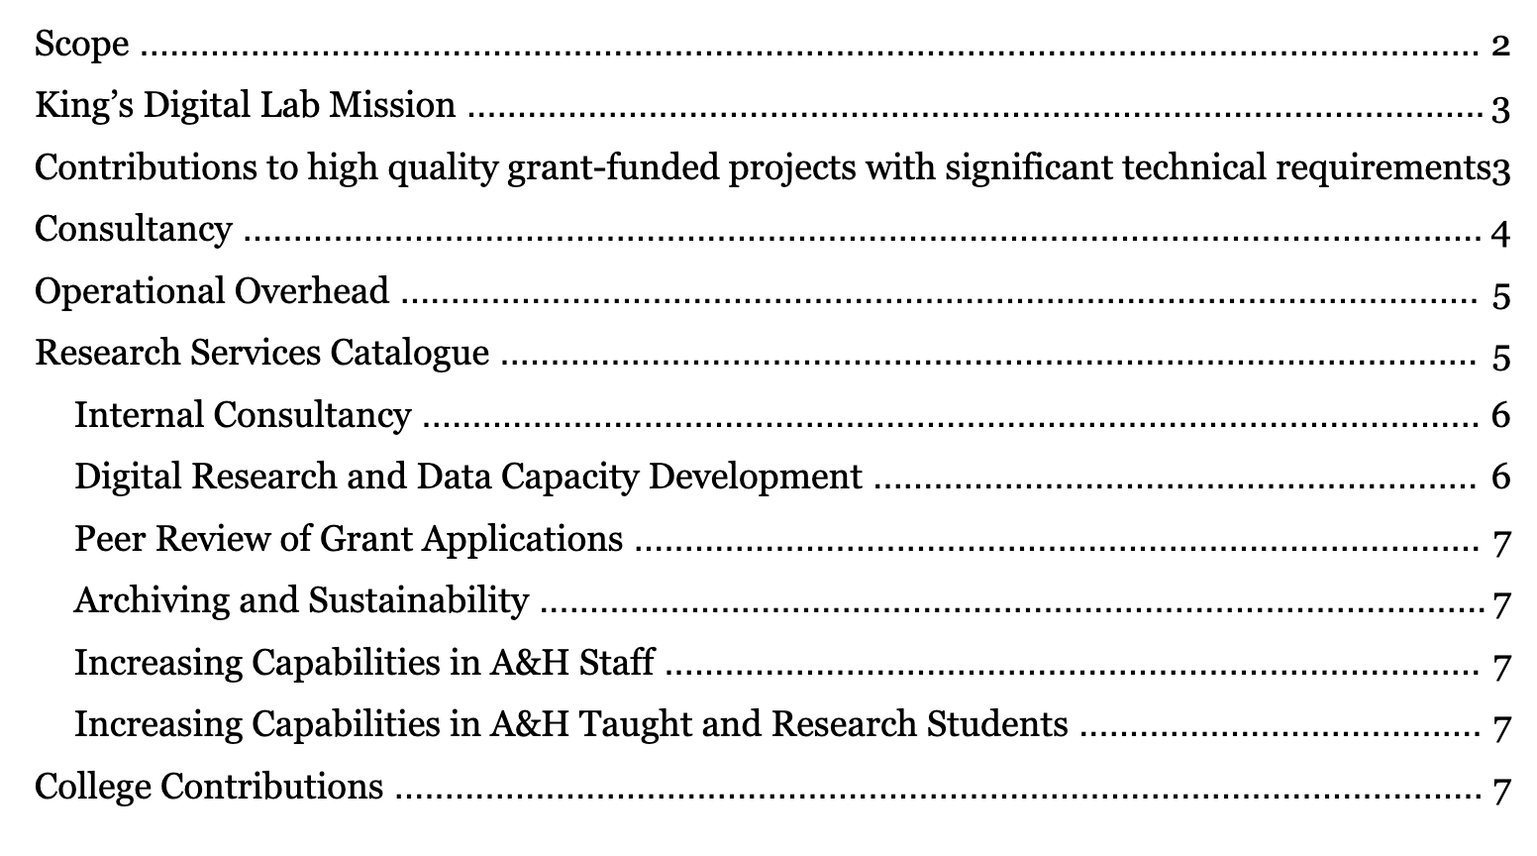
Mission & Activities Document Structure
Core remit
 | Contribution to research projects Operational overhead - including Research Themes
Additional activities
 | Research Service Catalogue – enhancing FAH research College contributions Consultancy

Slide 5
Mission & Primary Value
 | “KDL is a Research Software Engineering (RSE) laboratory in the Faculty of Arts & Humanities (A&H) charged with enabling and delivering high quality digital research. The core market for these research services is A&H researchers. For this reason, it works in collaboration with the A&H research leadership (A&H Research), through the activities led by the PVD [Pro Vide Dean] Research Culture and the PVD Impact & Knowledge Exchange. KDL also works externally, both elsewhere in the College (in particular via King’s e-Research and the Arts & Sciences Research Office) and outside the College, to enable and deliver digital research. KDL provides a focus in the College for arts and humanities RSE. KDL research software engineers “work with researchers to gain an understanding of the problems they face and then develop, maintain and extend software to provide the answers” [from past version of RSE UK Society site], informed by a critical understanding both of the technologies and of arts and humanities scholarship. This has proven value both within A&H and beyond, particularly in terms of contributions to REF and A&H’s ability to attract external research funding.”
 | KDL’s “primary value and market position lie in its contributions to high quality grant-funded projects with significant technical requirements”

Slide 6
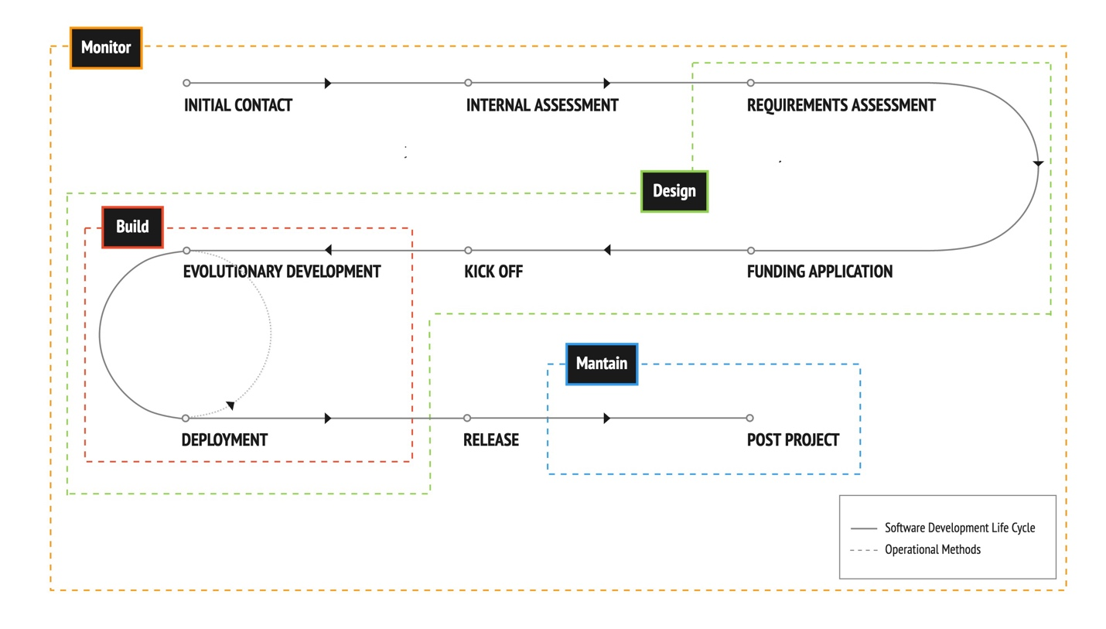
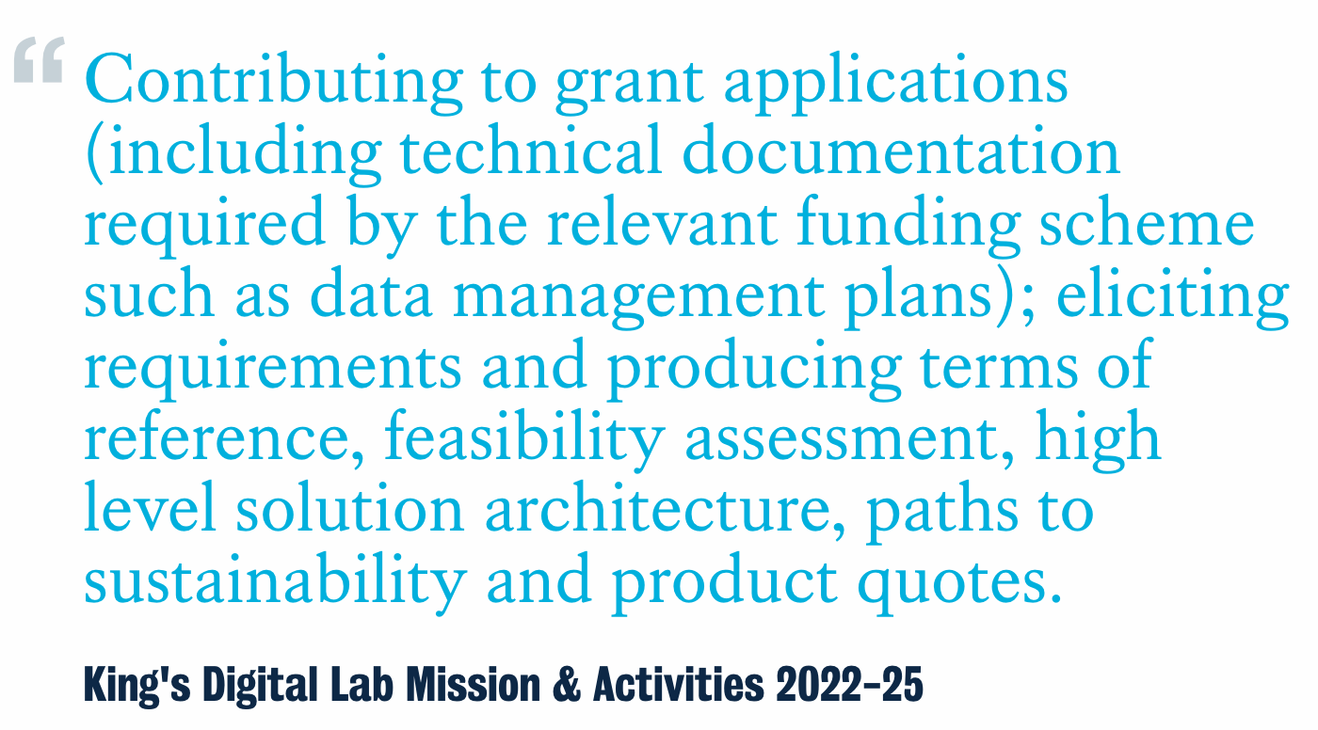
Inclusive Primary Value across Projects Lifecycles
 | Pre-grant analysis & support (including early concept phase)
Funded projects
 | Analysis, design, and development Contribution to research outputs Maintenance (covered by Service Level Agreements) Project management
 | See KDL Agile-DSDM aligned project templates

Slide 7
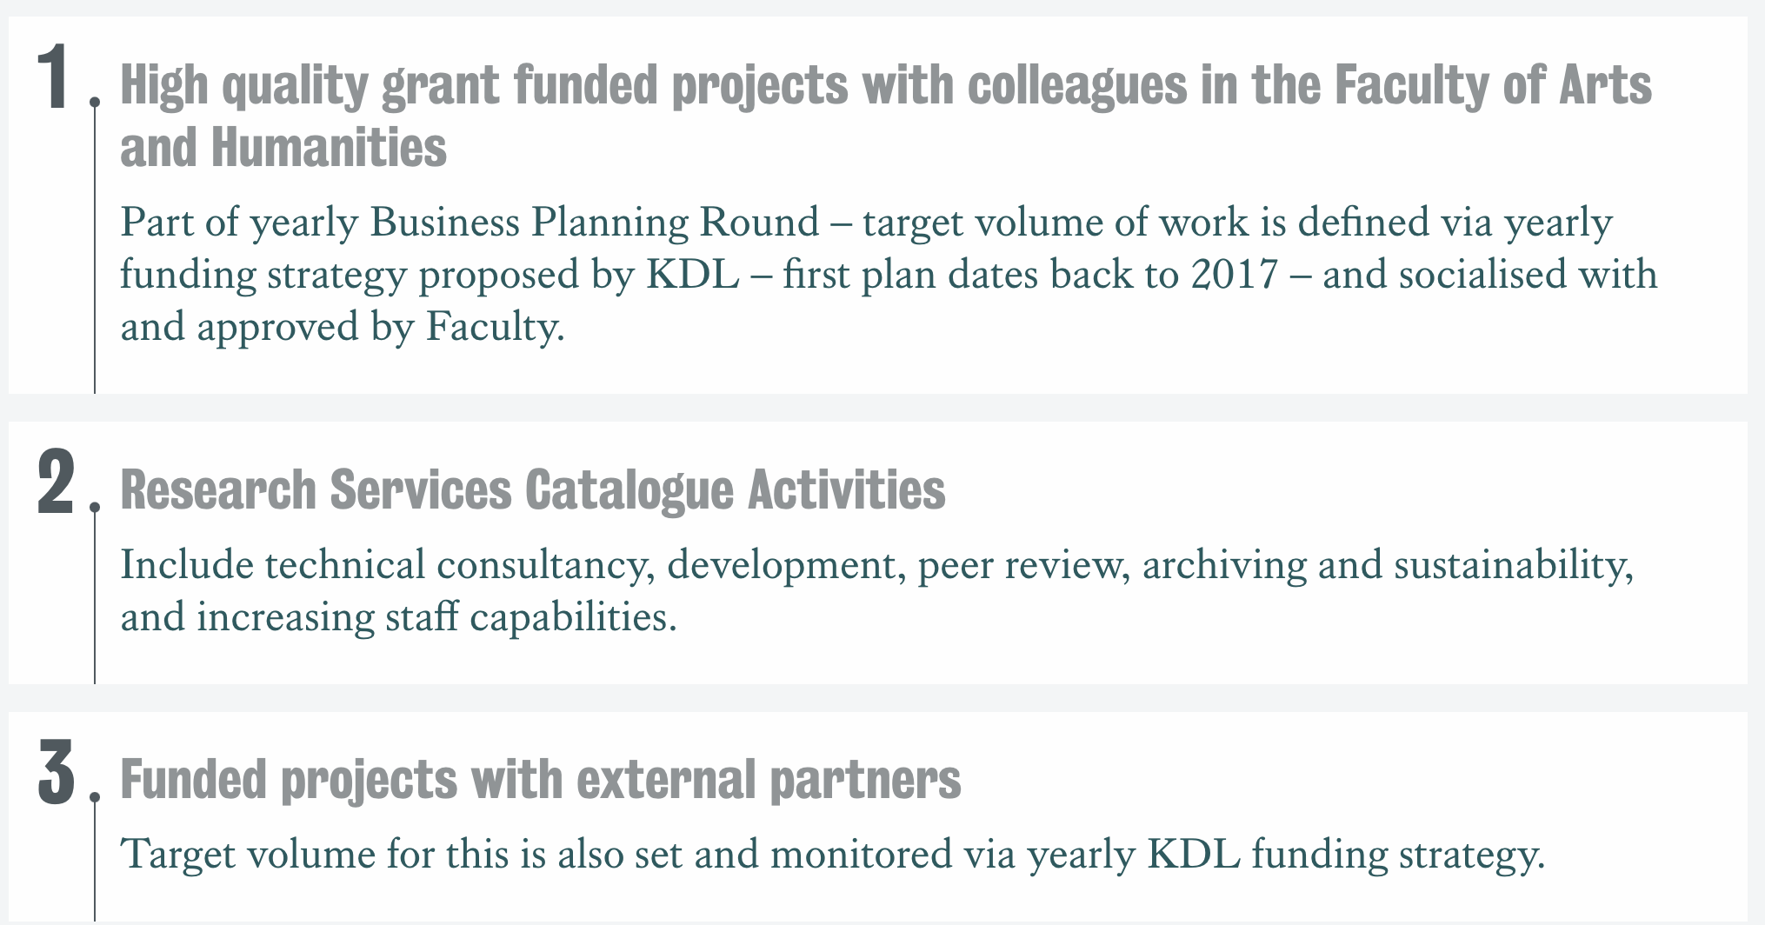
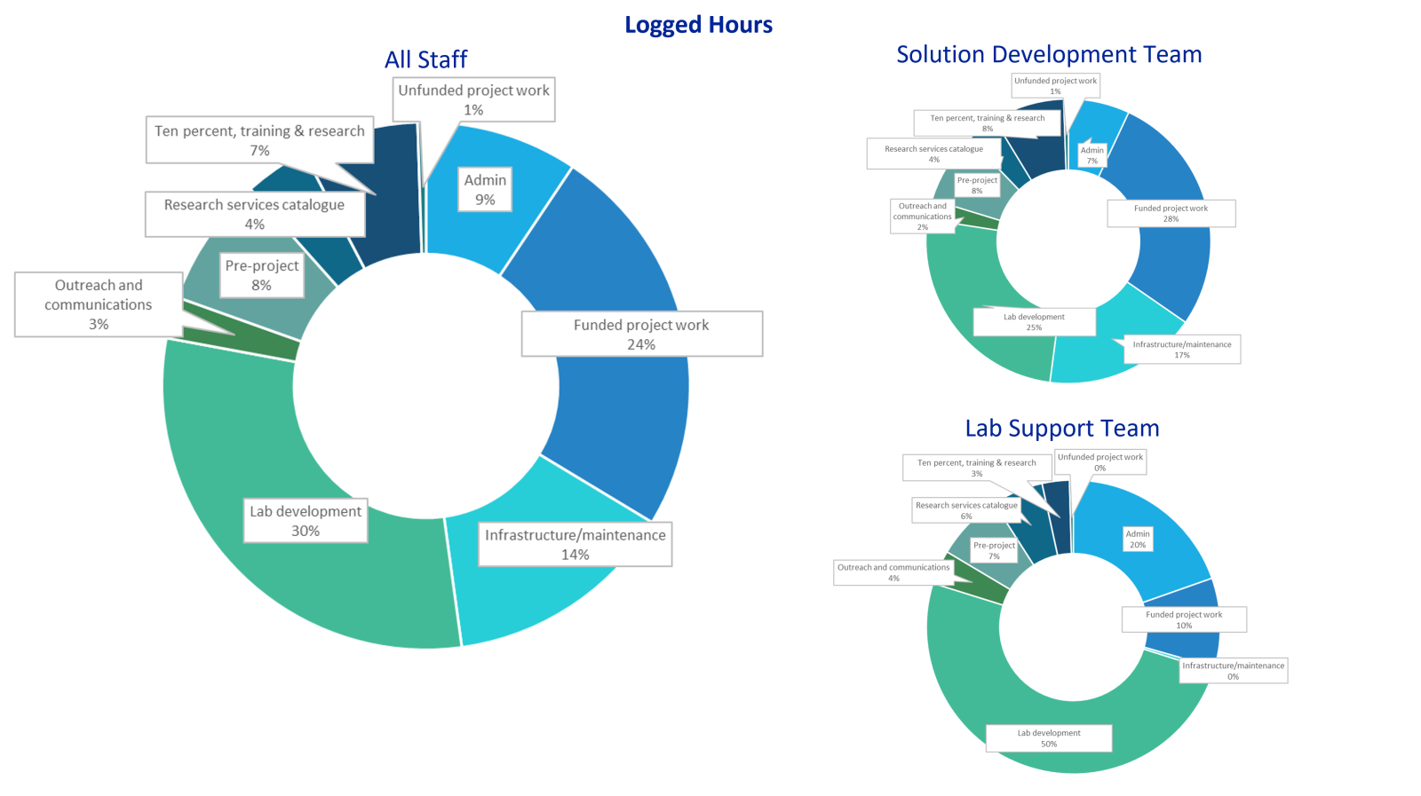
Capacity Allocation Priorities as TRAC-listed Research Facility
Commercial consultancy
 | Possible to offer but “cannot lead to an overshoot in TRAC billable hours”

Slide 8
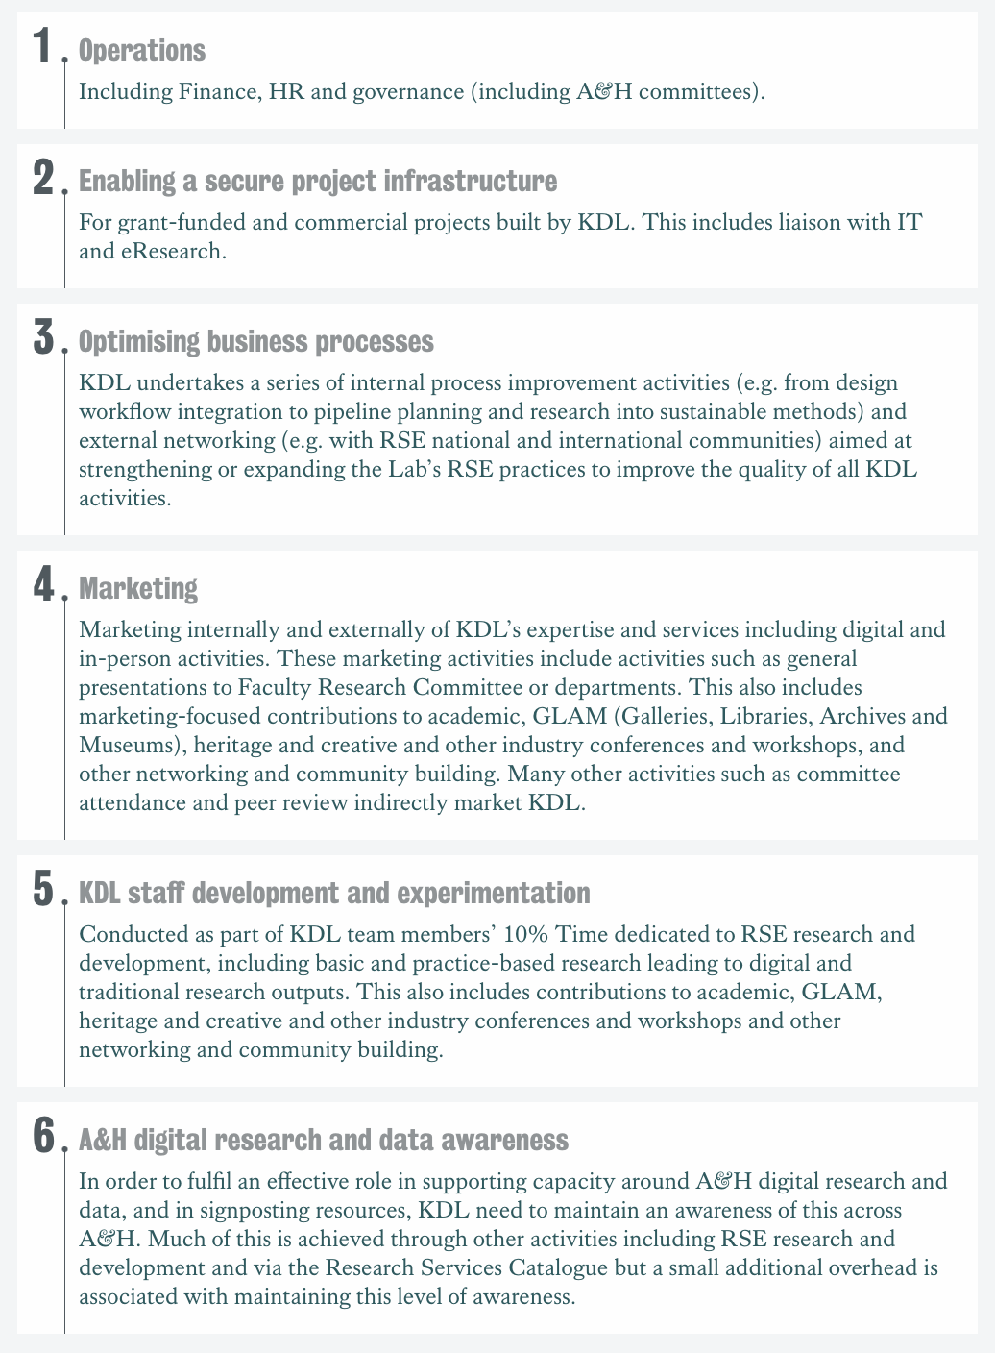
Operational Overheads
Photo by Bryan Goff on Unsplash
 | Community/ies
 | Lab Development
 | Personal Development

Slide 9
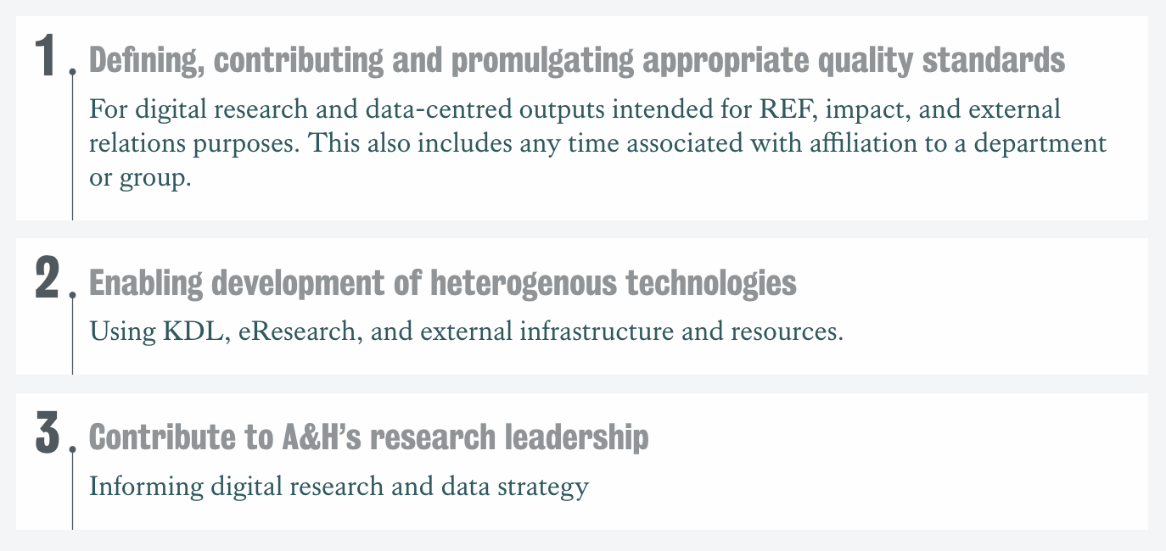
Research Services Catalogue
Digital Research and
Data Capacity Development

Slide 10
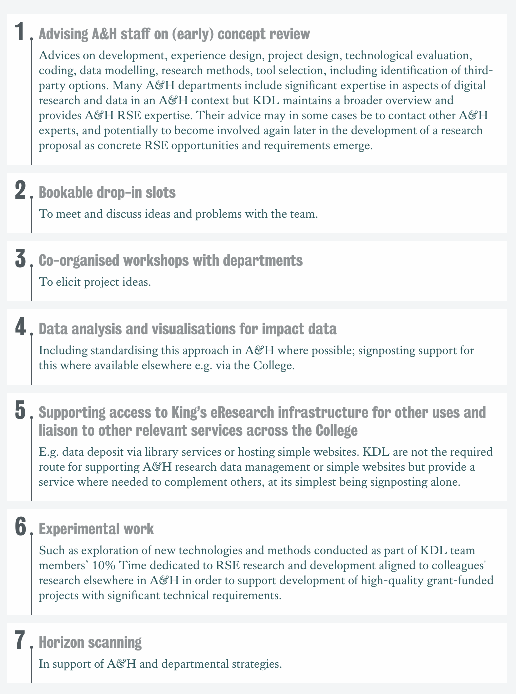
Research Services Catalogue
Internal Consultancy
Photo by Shane Rounce on Unsplash
Notes:
ed.

Slide 11
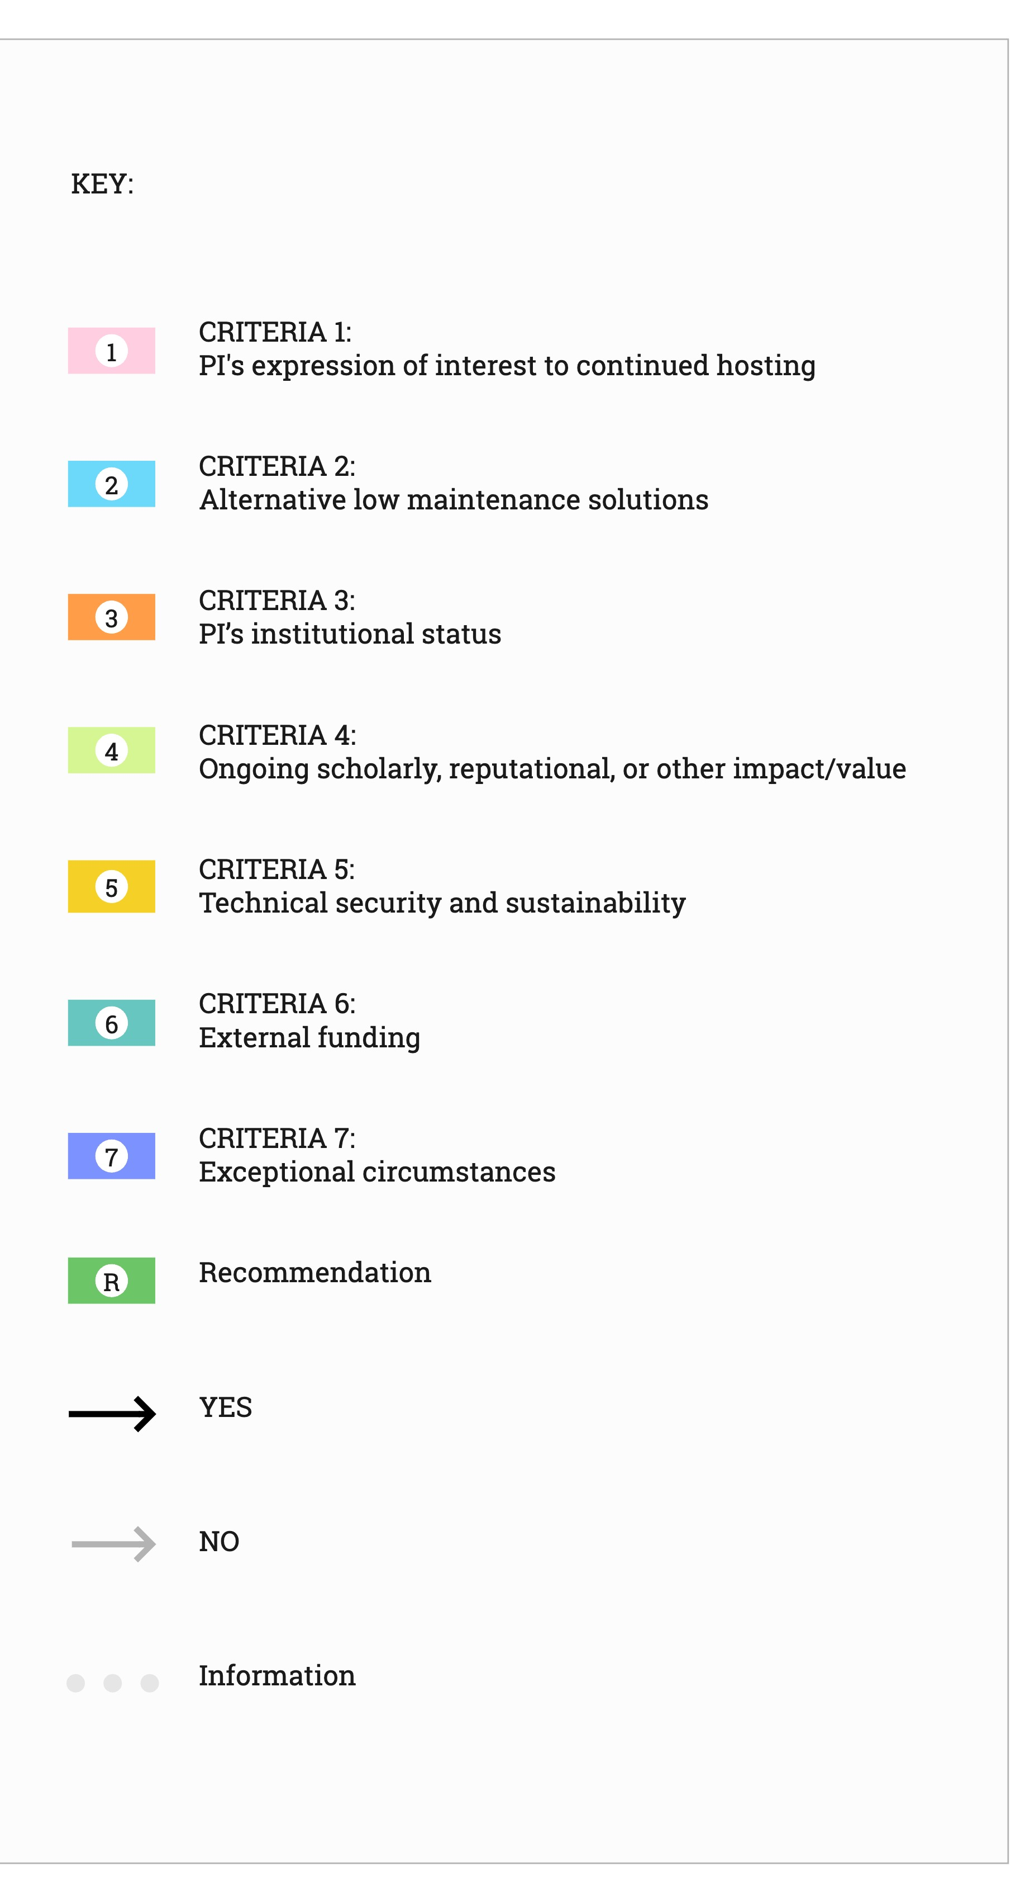
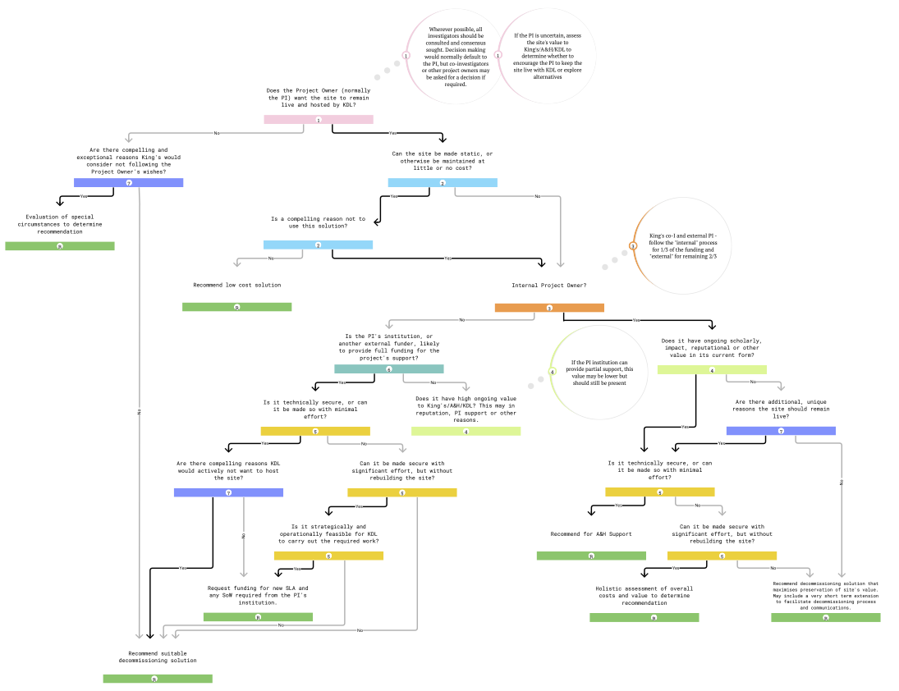
Research Services Catalogue
Archiving & Sustainability
Photo by Designecologist from Pexels
 | See https://www.kdl.kcl.ac.uk/our-work/archiving-sustainability/

Slide 12
Research Services Catalogue
Increasing Capabilities in A&H Students
 | TRAC framework Limitations
 | Eg. guest lectures, internships, visiting students
Standard training MA in Digital Humanities >> Introduction to Digital Humanities >> Product Development >> Digital Interactions in Cultural Heritage >> Web technologies >> Coding and the Humanities MA in Digital Asset and Media Management >> Introduction to Digital Asset and Media Management MA in Global Cultures | Non-standard training User Experience (UX) Design (Fourth Rev)
quokkabottles on @unsplash
 | Ongoing review of KDL contribution to educational offer

Slide 13
College Contributions
 | (indirectly via other activities) Digital research and data strategy & operations (specific inputs) e.g. relevant College committees (e.g. KCL AI Insitute) and working groups development of digital research and data capacity via training
Benefits
 | Holistic account of RSE expertise Workload management Delegation Demand and expectations management
SeanRobertson on @unsplash

Slide 14
Link to template
Thank you!
QUESTIONS?

